Slide 1
Panel Discussion:
STEM Policies Supporting Student Success
December 8, 2017
Dr. Ruth Kermish-Allen
Executive Director

Slide 2
Vision:
To inspire and foster critical thinking, problem solving, and civic engagement through STEM education.
Mission:
Developing professional development experiences for K-12 educators that apply research-based best practices in Science, Technology, Engineering, and Math (STEM) education
Conducting research and evaluation of STEM learning experiences to advance our knowledge of what works for rural STEM education in Maine and the Nation
Building relationships and networks to sustain systemic statewide improvement in K-12 STEM education
Notes:
Vision:
To find inspiring new ways to get people excited about Science, Technology, Engineering, & Math today
– so that our youth can become the innovators and workforce of tomorrow.
Mission:
We support educators to teach STEM in more meaningful ways.
Vision:

Slide 3
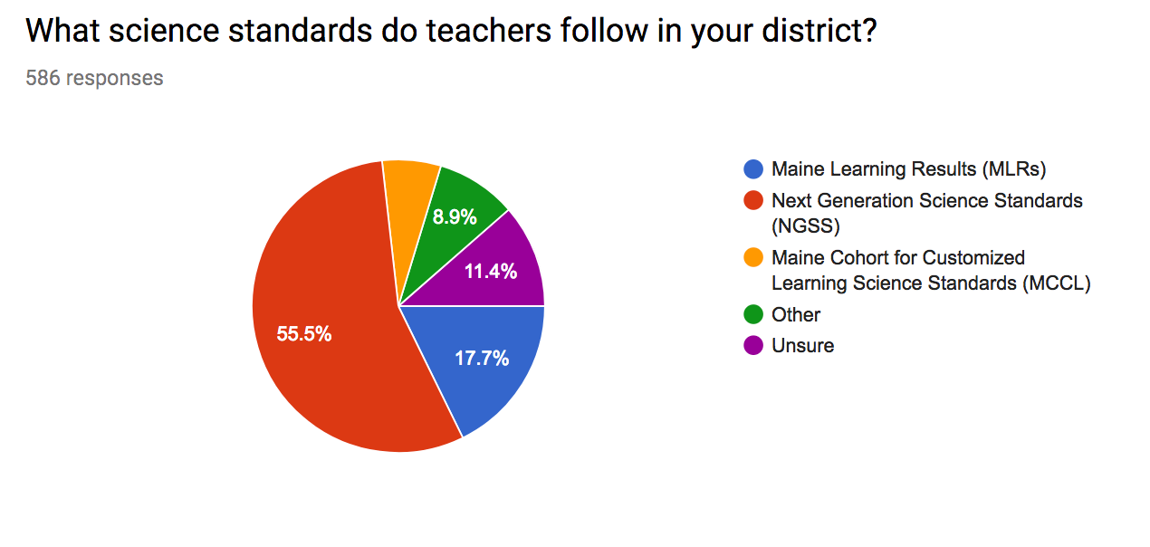
Need To Know
60% of Maine’s school districts have locally adopted the NGSS
Maine Science Teachers Association statewide survey
Notes:
Why – because teachers know that…
Overwhelming research that children learn by doing and experiencing STEM, not memorizing content
Outdated assessments that only measure content aligned with 15 year old outdated science standards

Slide 4
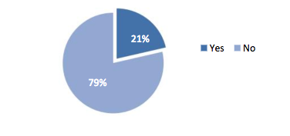
Are there sufficient STEM professional development opportunities regularly provided to educators at your school?
Need To Know
Campus Compact STEM report

Slide 5
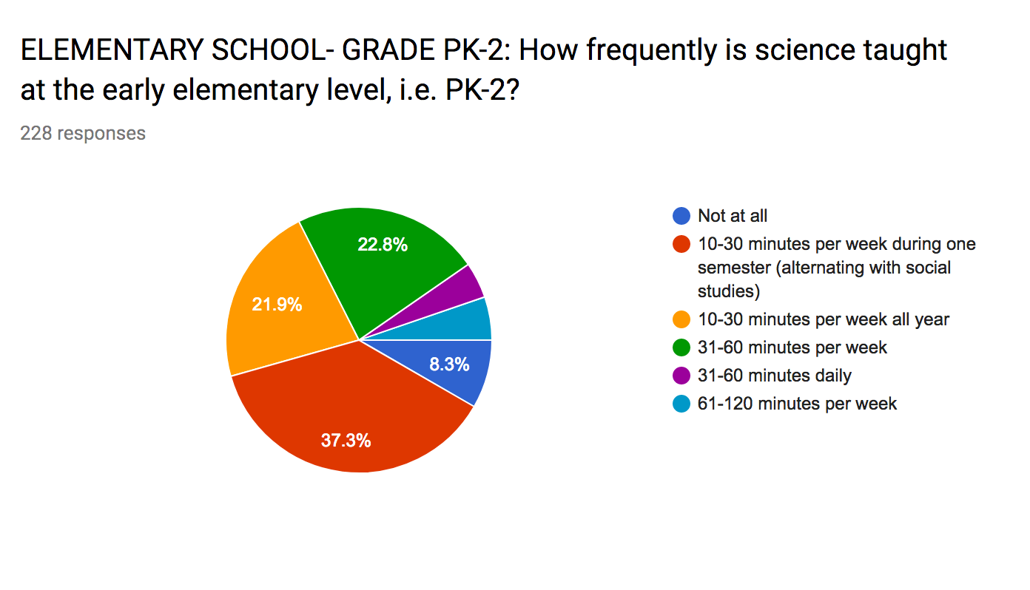
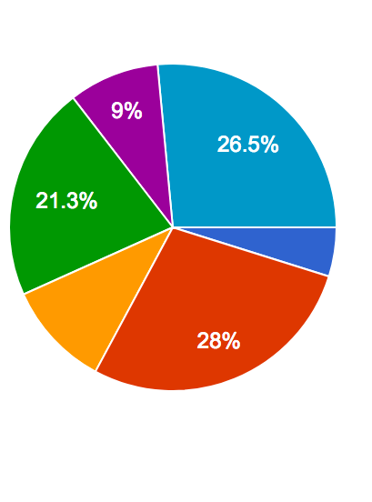
How frequently is science taught at the elementary school in your district?
Need To Know
K-2
3-5
K-2
Maine Science Teachers Association statewide survey

Slide 6
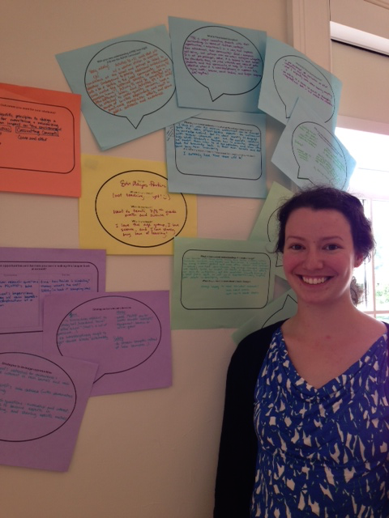
Taking Action:
Find out what your local ESSA plan is and the role of STEM in that plan – hint: it may still be under development
Seek out high quality professional development for your schools – is it really based on research-based evidence and practice.
Take advantage of already existing professional development opportunities
Notes:
ESSA plans will be determined locally.
https://mmsa.org/events/
STEM integration
Understanding NGSS and how to integrate it into your classroom
Understanding the math practices
STEM family Night
Family Code night this week

Slide 7
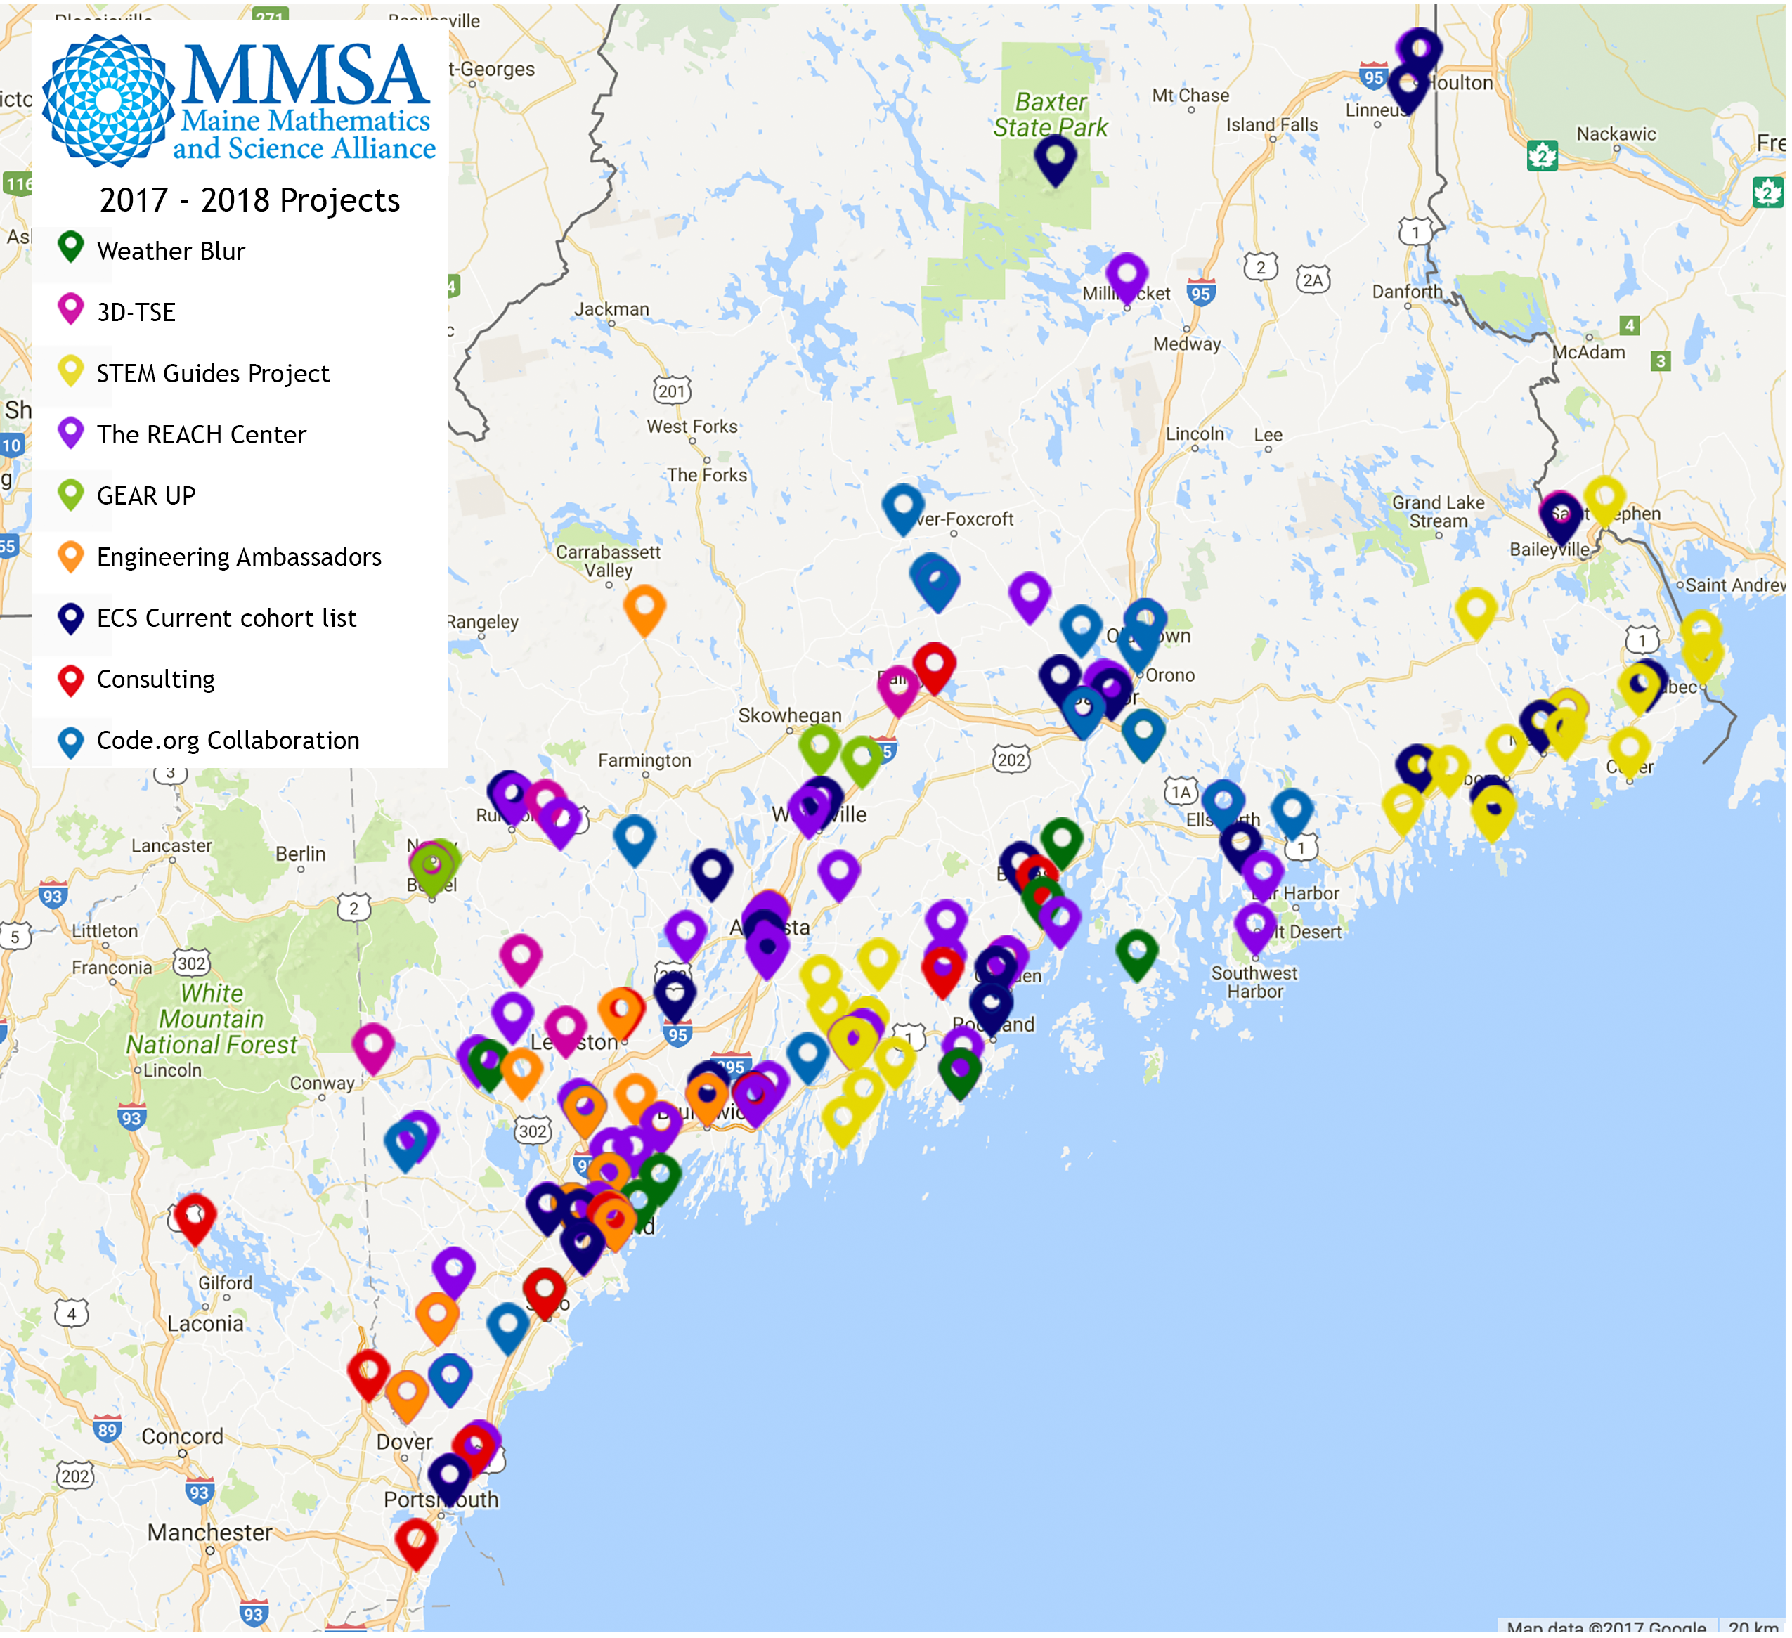
JOIN THE STEM MOVEMENT

Slide 8
Professional Development
MMSA
Bridge formal and informal learning environments
Integration not isolation of STEM
Partner with local STEM industry
Experiential STEM as a great fit for proficiency-based education
New modes of STEM professional development
Notes:
Engineering Ambassadors
Math and Science Through Engineering
WeatherBlur
Proficiency based STEM integration
Afterschool Coaching for Rural Educators in STEM (ACRES)

Slide 9


A Case Study
AR Girl
Using storytelling and design as a “back door” to STEM competencies and computer science
Partnerships with Maine arts organizations
Targeting rural girls not considered the “usual suspects” Communicating science in partnership with scientists
Training arts educators in computer science

